Slide 1
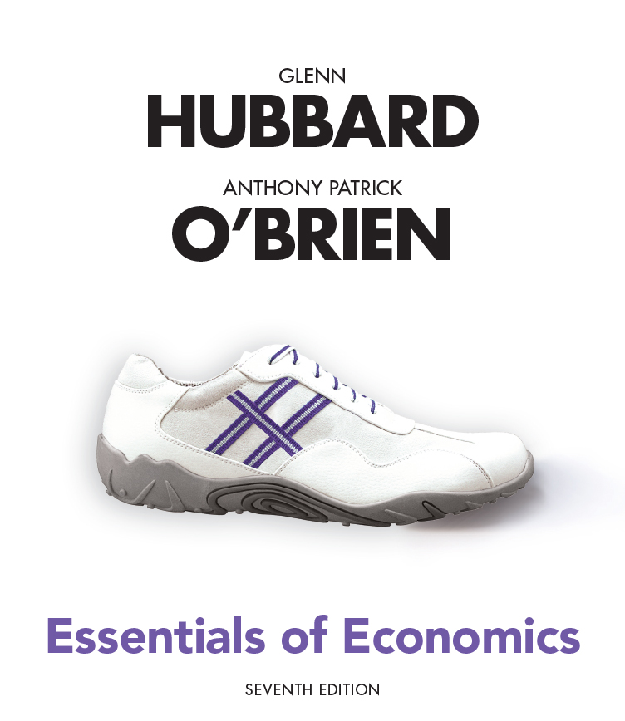
Essentials of Economics
Seventh Edition
Chapter 13
Unemployment and Inflation
Copyright © 2021, 2019, 2017 Pearson Education, Inc. All Rights Reserved.
Notes:
If this PowerPoint presentation contains mathematical equations, you may need to check that your computer has the following installed:
1) MathType Plugin
2) Math Player (free versions available)
3) NVDA Reader (free versions available)

Slide 2
Chapter Outline
Part 2
13.4 Measuring Inflation
13.5 Using Price Indexes to Adjust for the Effects of Inflation
13.6 Nominal Interest Rates versus Real Interest Rates
13.7 Does Inflation Imposes Costs on the Economy?

Slide 3
13.4 Measuring Inflation
Define the price level and the inflation rate and understand how they are computed.
In the previous chapter, we introduced the idea of the price level: a measure of the average prices of goods and services in the economy.
We refer to the percentage increase in the price level from one year to the next as the inflation rate.
Two commonly-used measures are:
The consumer price index (CPI)
The producer price index (PPI)

Slide 4
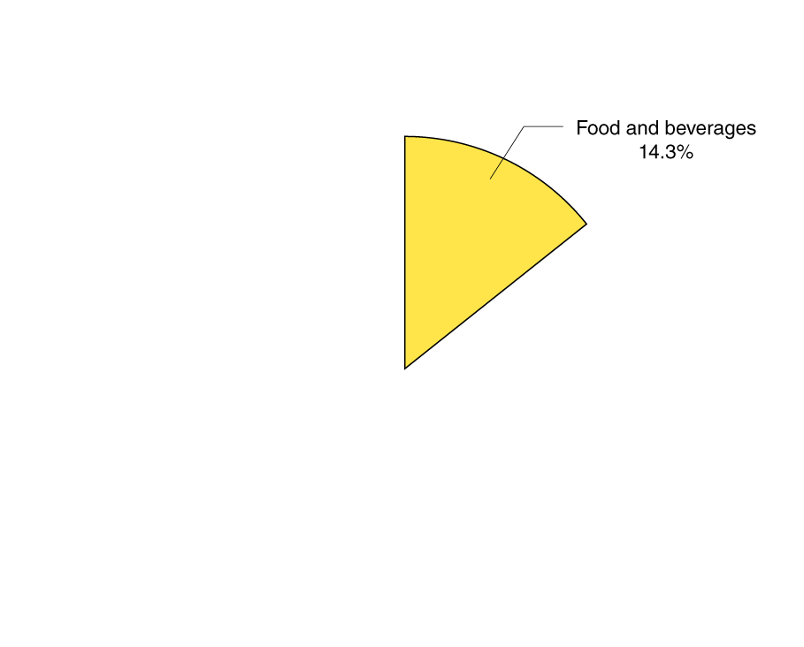

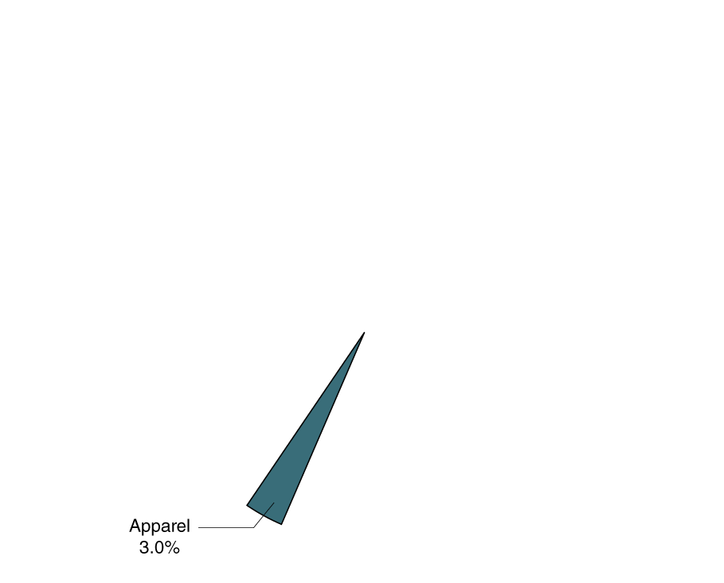
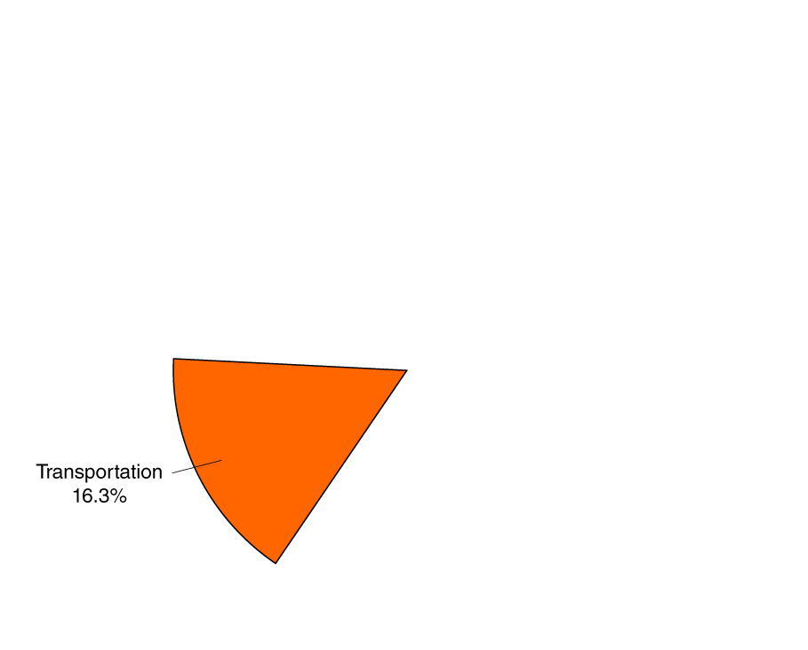
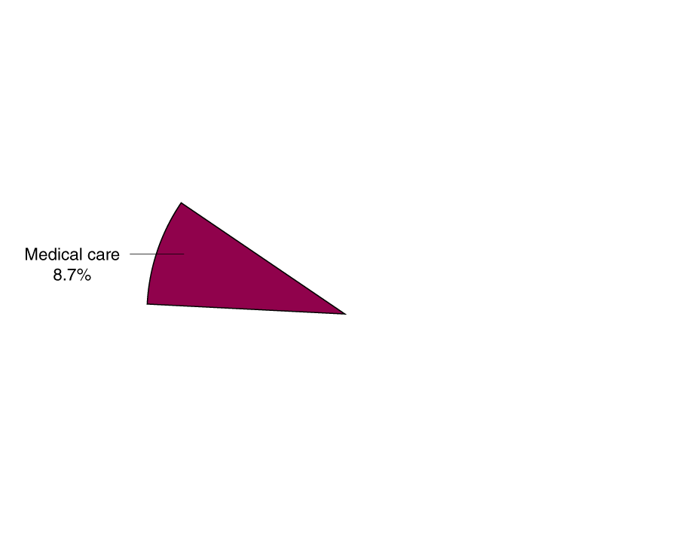
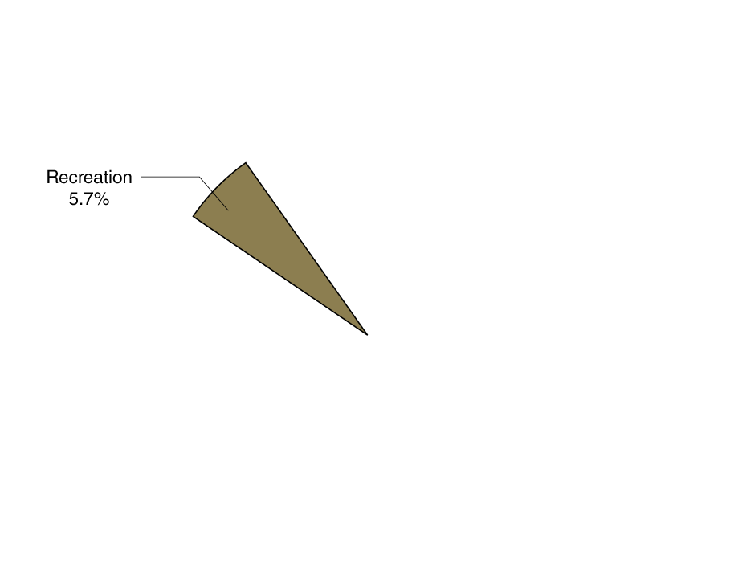
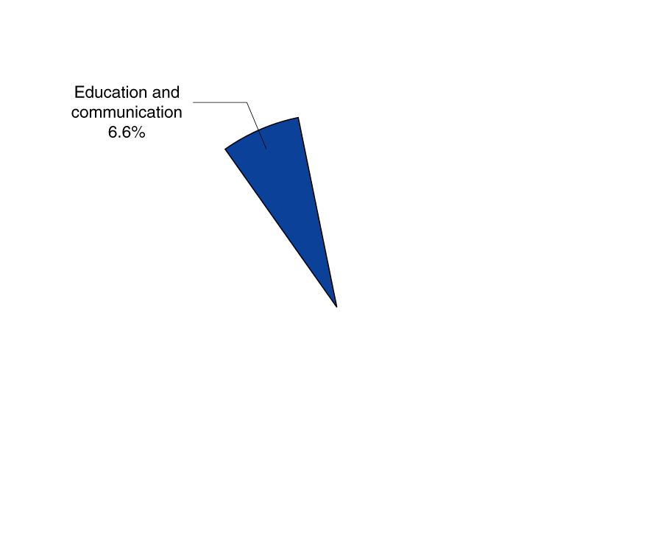
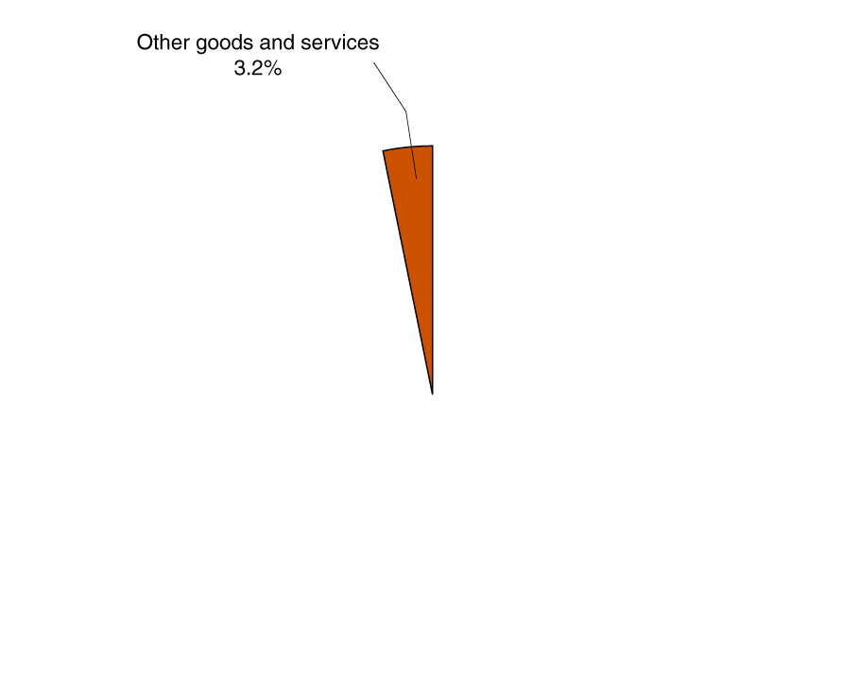
Figure 13.7 The CPI Market Basket, December 2018
The consumer price index (CPI) is a measure of the average of the prices a typical urban family of four pays for the goods and services they purchase.
The chart shows the composition of the basket of goods used to create the CPI. This basket of goods derives from a survey of 14,000 households by the BLS.

Slide 5
Calculating the CPI
To calculate the CPI in a given year, we need:
A basket of goods
The cost to purchase the basket of goods in a base year
The prices in the current year
The CPI in the current year is the cost to purchase the basket of goods this year, divided by the cost in the base year. By convention, we multiply this by 100, so that the CPI in the base year is 100.

Slide 6
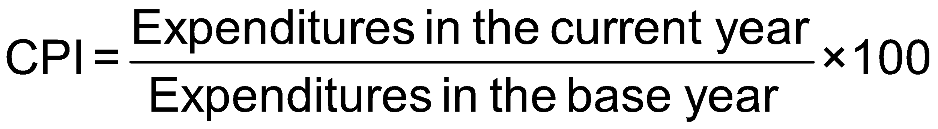
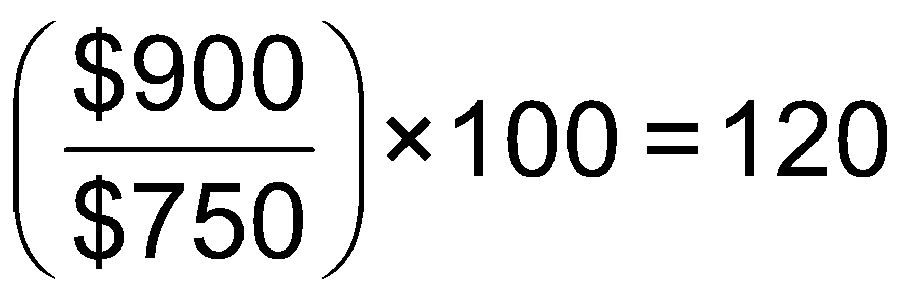
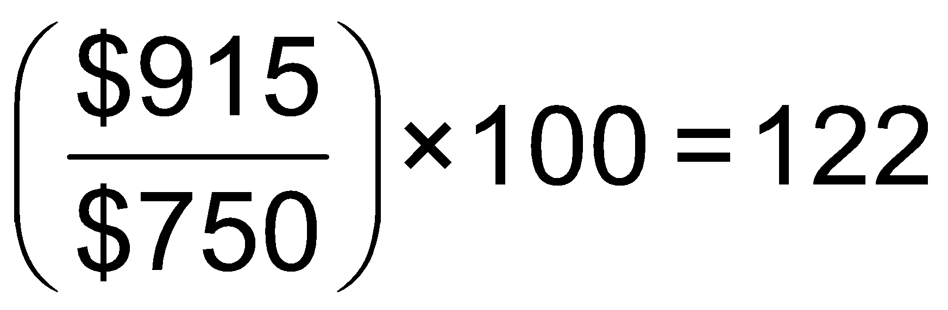
A Simple CPI Calculation (1 of 2)
Blank | Blank | Base Year (2010) | Blank | Blank | 2020 | Blank | 2021
Product | Quantity | Price | Expenditures | Price | Expenditures (on base-year quantities) | Price | Expenditures (on base-year quantities)
Eye examinations | 1 | $50 | $50 | $100 | $100 | $85 | $85
Pizzas | 20 | 10 | 200 | 15 | 300 | 14.00 | 280
Books | 20 | 25 | 500 | 25 | 500 | 27.50 | 550
TOTAL | Blank | Blank | $750 | Blank | $900 | Blank | $915
The table above gives the information we need to create the CPI in 2020 and 2021, using the basket of goods from 2021.
Formula | Applied to 2020 | Applied to 2021

Slide 7
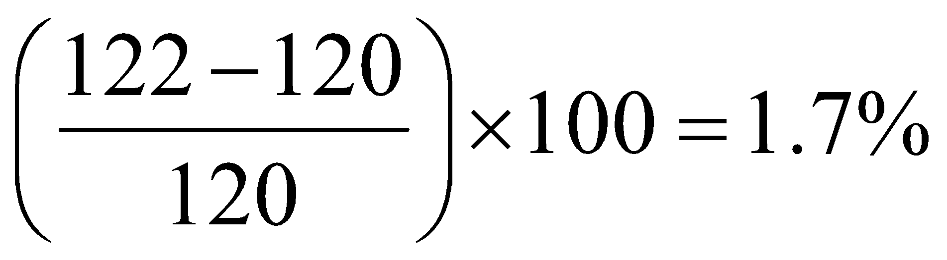
A Simple CPI Calculation (2 of 2)
Formula | Applied to 2020 | Applied to 2021
Based on these data, the inflation rate from 2020 to 2021 is the percentage change in the CPI:
Since the CPI measures consumer prices, it is often referred to as the cost of living index. CPI-inflation is sometimes used to generate “fair” increases in wages for workers and government benefits.

Slide 8
Is the CPI an Accurate Measure of Inflation?
Some potential problems with the CPI include:
Substitution bias: Consumers may change their purchasing habits away from goods that have increased prices.
Increase in quality bias: It is difficult to separate improvement in quality from increase in price, say in cars or computers.
New product bias: The basket of goods used to change only every 10 years. (Now it updates every 2 years.) There is a delay to including new goods like cell phones.
Outlet bias: CPI used to only survey prices at traditional retail outlets. Now it tries to minimize this bias by surveying people about where they actually buy products.
Economists believe the CPI overstates true inflation by 0.5 to 1 percentage point (an improvement over previous methods).

Slide 9
Producer Price Index
The producer price index (PPI) is an average of the prices received by producers of goods and services at all stages of the production process.
It is conceptually similar to the CPI, in that it uses a basket of goods, but the goods are those used by producers.
Includes raw materials like coal and crude petroleum, and intermediate goods like flour, yarn, steel, and lumber.
The PPI can give early warning of future movements in consumer prices.

Slide 10
Nominal and Real Variables
The current standard base “year” for the CPI is an average of 1982-1984 prices.
Values like wages in current-year dollars are called nominal variables. When we adjust them for inflation, by dividing by the current year’s price index and multiplying by 100, we convert them to real variables.
This is useful for comparing variables across time.

Slide 11
13.6 Nominal Interest Rates versus Real Interest Rates
*REAL VALUES ARE WHAT WE CARE ABOUT NOT NOMINAL VALUES, EVEN FOR INTEREST RATES
When you lend money to someone, they typically agree to pay you back with interest. If the interest rate is 4 percent, for example, then a $1,000 loan paid back in a year will be paid back with $1,040.
4 percent is the nominal interest rate: the stated interest rate on a loan.
We can adjust for inflation by calculating the real interest rate, equal to the nominal interest rate minus the inflation rate.
This is an approximation, but it is quite accurate for low interest and inflation rates.
If prices rise by 2 percent from this year to next, then your real interest rate on the loan is only 2 percent. This more accurately reflects the cost of borrowing and lending money.

Slide 12
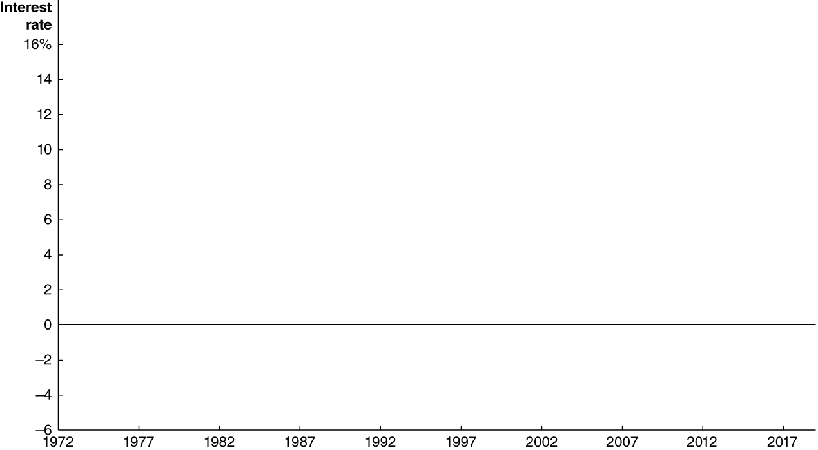
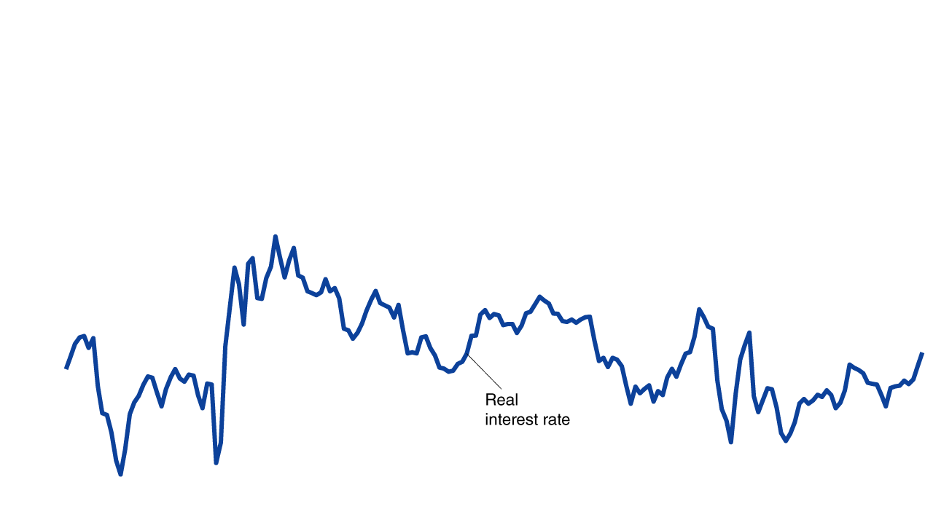
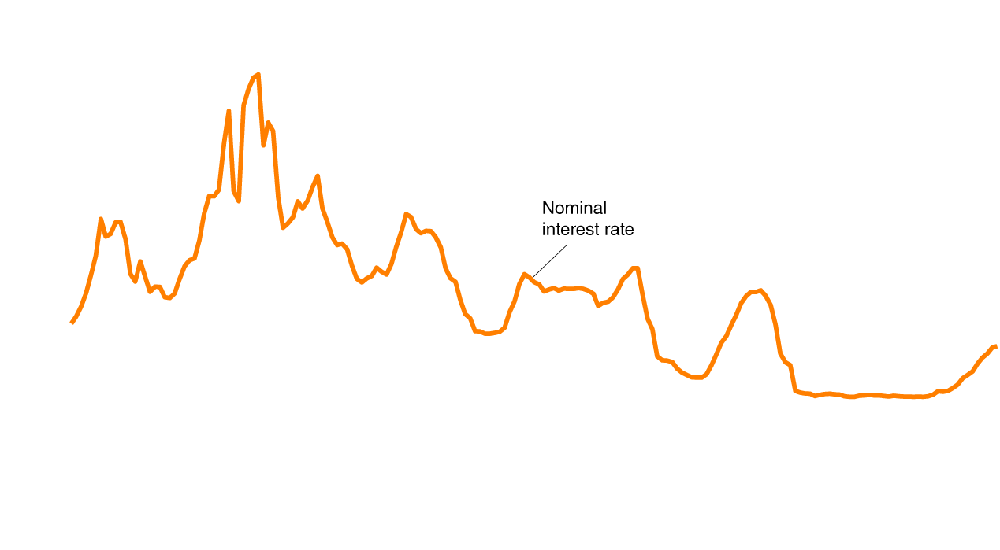
Figure 13.8 Nominal and Real Interest Rates, 1970-2017
The chart shows the interest rate on three-month treasury bills, a good measure of the nominal interest rate.
The real interest rate adjusts them for changes in the CPI.
In 2009, the real interest rate was above the nominal interest rate. The change in the CPI was negative then, indicating a rare deflation, or decline in the price level.

Slide 13
13.7 Does Inflation Impose Costs on the Economy?
Sometimes inflation seems unimportant.
If all prices doubled overnight, it seems like nothing much would change: the prices of goods and services would have doubled, but so would your wage.
So you could afford exactly as much as before.
But not all prices and wages rise at the same rate.
So some people will see their real wage increase due to inflation, while others will see it decrease.
Particularly for people on fixed incomes (e.g. retirees), inflation can seem unfair, as the purchasing power of their income falls.

Slide 14
The Problem with Anticipated Inflation
Even if inflation is anticipated, it still causes problems:
Because some prices and incomes will remain fixed, some redistribution of income will occur.
People and firms have increased real costs of holding cash. (The cash that they hold will decrease in value.)
Firms have menu costs: the cost to firms of changing prices. Frequently changing prices are inconvenient for firms (and consumers too!) to deal with.
Investors are taxed on nominal returns, rather than real returns; so this can increase the tax due.

Slide 15
The Problem with Unanticipated Inflation
When people cannot predict the rate of inflation, they find it hard to make good borrowing and lending decisions.
For example, in 1980 banks were charging 18 percent or more on home loans because the rate of inflation was very high. People who bought homes were locked into high rates even when inflation subsided.
On the other hand, if banks lend money at a low rate and then high inflation takes place, the real interest rate they receive may be zero or negative; thus the risk of inflation makes banks wary of lending.
Unpredictable inflation makes borrowing and lending risky.

Slide 16
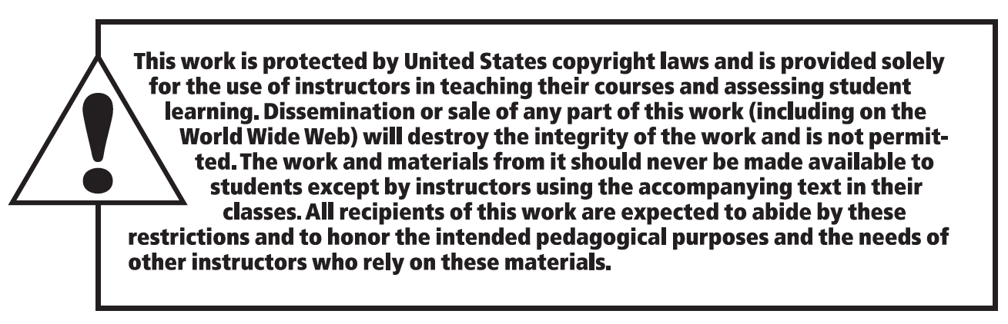
Copyright

